Slide 1
Unique Corns
Parth Champaneri, Allen Hsiao, Clare Kim,
Jenny Kondrashikhin, Pascal Queeney, Patrick Tan

Slide 2

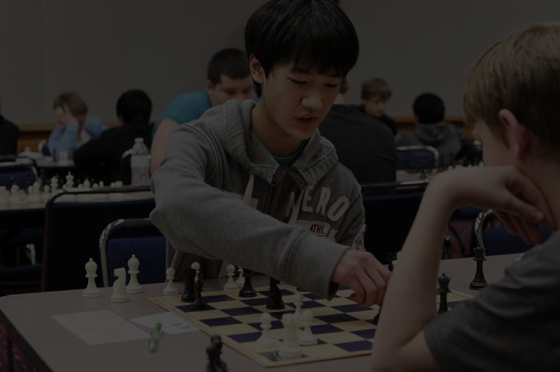


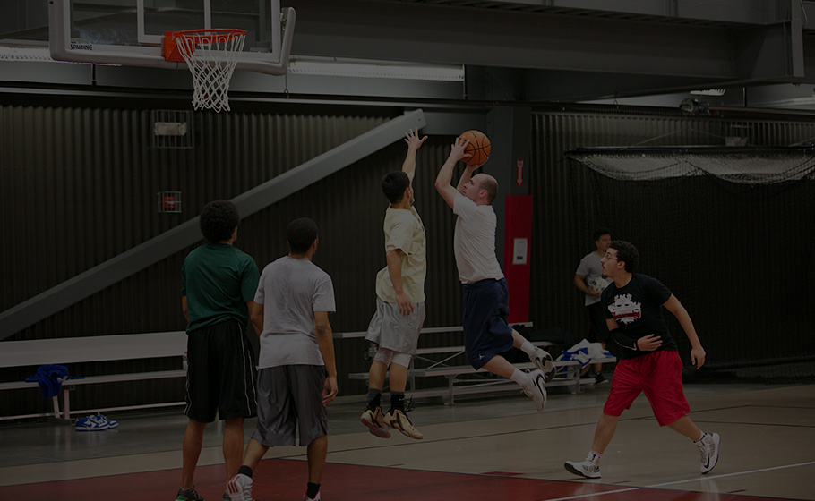

get connected
build a social circle
get active within the community
personal health + well-being

Slide 3


Slide 4
Problem Statement
Transitioning into a new community can be difficult or even challenging for some. We are unaware of many events that happen around us and we miss the opportunity participate in things that interest us as well as a chance to meet new people.
Our vision is to develop a solution which can will give
people who are new to communities an opportunity to connect with people around them who share the same interests.

Slide 5
Design of Formative Study #1
Questionnaire

Slide 6

Stakeholder Groups
{
Exchange Students
International Students
Undergraduate Students
First Year Students
Student Club Members
Presidents
Representatives
Graduate Students
Students
Notes:
Explain, the target body as a whole is the student body then list off the types of students.

Slide 7


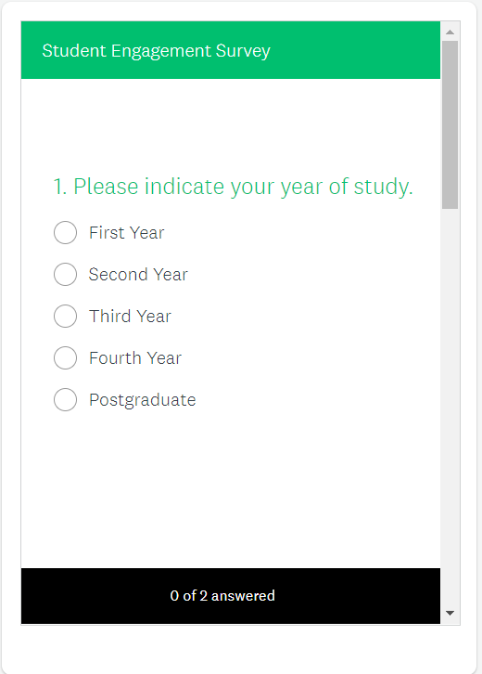
Instruments
Phone/Tablet
Survey Monkey
(Digitally distributed)

Slide 8
Research Question for Questionnaires
We are trying to learn about... what difficulties students have when transitioning into a new community
because we want to find out... how different students struggle with different student outreach issues
in order to understand... the particular aspect of student engagement that is most problematic.

Slide 9
Protocol
Spread across different campus buildings in groups, ask students to participate in survey / Distribute survey through social media
Briefly introduce problem statement
Ask if the participants has any question prior to starting
Administer the online survey, let participant complete survey
Ask if the participant would like to participate in follow-up interview
Estimated time: 1 Hour
Analyze data for future use in solution
Notes:
Basically, just talk about how we will conduct this experiment. Our step by step process on what should be a successful study in our perspective. Can probably elaborate on what these 3 groups will be (who their TA will be)
Want to learn about what motivates students to attend events
What kind of events
How do they learn about events on campus
What kind of events would student want to attend
Draw comparisons between:
commuters/on-campus residence/off-campus
international/domestic/exchange/out of province/from GTA/out of GTA
first year/upper year
Program of study
Gender

Slide 10
Draft of
Formative Study
#2
Interview

Slide 11



Initial Ideas
01
How to recruit?
Recruitment through questionnaire. Free coffee offered as incentives.
02
How many interviewee?
Depends on time and interest.
Aim for at least 10.
03
What type of interview?
Semi-structured interview.
Flexible + Casual
To refine + elaborate from the questionnaire
Identify and interview specific student groups
Gain insight on individual problems + coping strategies
Notes:
Identify and interview specific student groups
What do we expect in terms of the data from research?
How are we going to use this data? To refine and elaborate on what we learned from the questionnaire
What is our idea? *what does this question want?* If the reason is because events info is not readily available ->

Slide 12
Any Questions?

